Slide 1

Project Proposal
Piyush Shinde
Saurabh Kumar
Shubhankar Mitra
*
Notes:
1

Slide 2
Overview
INDIANA UNIVERSITY BLOOMINGTON
*
Task 1:
Restaurant Recommendations
Experiment Design
User similarity based recommendations:
Item similarity based recommendations
TF-IDF
NMF
Doc2Vec
Apache Spark ALS Matrix factorization
Factorization Machine using tensorflow
Task 2 :
REVIEW IDENTIFICATION FOR USER SUPPLIED WORD USING LDA AND WORD2VEC
LDA topic generation
Experimentation to adjust parameters with reviews from some 200 restaurants by seeing texts for top 20 reviews obtained for a keyword
Evaluation using categories column for user provided keyword from review text of 1200 restaurants

Slide 3
Task Allocation
INDIANA UNIVERSITY BLOOMINGTON
*
Piyush Shinde | Saurabh Kumar | Shubhankar Mitra
Training, evaluation, and test dataset creation (Data Manipulation code) for Task 1 according to experiment design specifications. Code – Complete data manipulation, complete user based filtering using NMF, Doc2Vec and TF-IDF Report – Data Generation, Model Creation, Content Based Recommendation, User Based Similarity, Evaluation (User Based) | Task 1: Item Similarity Based Recommendations using TF-IDF NMF Doc2Vec Code – Complete item based filtering using NMF, Doc2Vec, TF-IDF Report – Abstract, Introduction, block diagrams in Data Generation, Item Based Similarity, Collaborative Filtering, Evaluation (Item Based), Results, Conclusion and Future Enhancements | Code – Complete Code of Task 2 Ran code to convert Yelp Json data to csv Wrote function for finding user and item similarity (Function name in code: calc_sim_user_rating) in Task 1 Provided example code for Dec2Vec training, NMF for User similarity and Item similarity in Task 1 Wrote and ran code for collaborative filtering (Task1 - ALS Matrix Factorization) Report – Complete part of Task 2
Task 1: User Similarity Based Recommendations using TF-IDF NMF Doc2Vec | Additional: Executed Task 1 on Burrow. | Task 2 Complete algorithm design, writing code and evaluation.

Slide 4
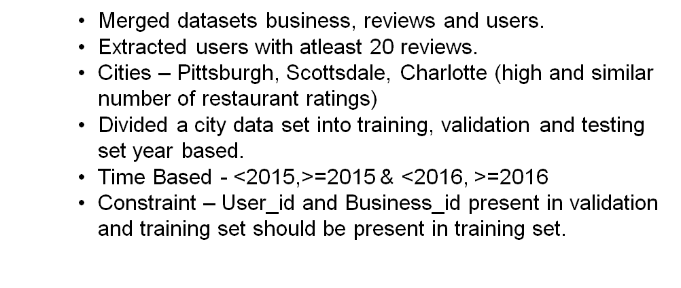
Task 1: Experiment Design
INDIANA UNIVERSITY BLOOMINGTON
*

Slide 5
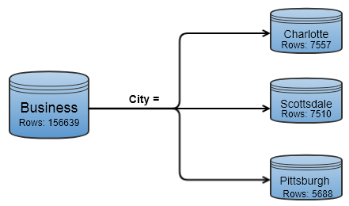
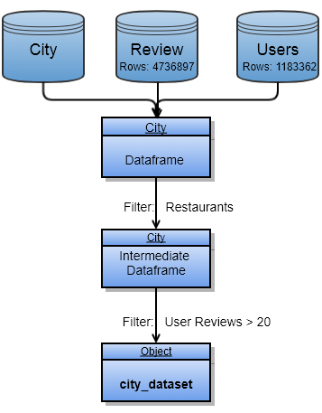
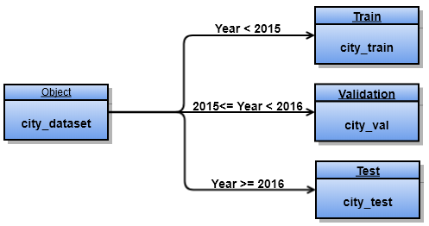
Task 1: Experiment Design
INDIANA UNIVERSITY BLOOMINGTON
*

Slide 6
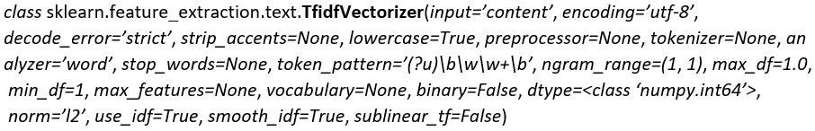
Task 1: Feature Extraction Techniques
We used 3 feature extraction techniques:
1. Non-Negative Matrix Factorization (NMF)
2. Term Frequency–Inverse Document Frequency (TF-IDF)

Slide 7
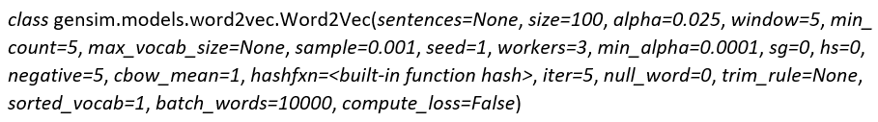
Task 1: Feature Extraction Techniques
3. Doc2Vec

Slide 8


Task 1: Algorithms
INDIANA UNIVERSITY BLOOMINGTON
*
1) User Based Similarity
2) Item Based Similarity
Similarity is found using TF-IDF, NMF and Doc2Vec

Slide 9
Task 1: Evaluation
Parameter Tuning was performed on the validation set on the parameters :
n_components in NMF
window and size in Doc2Vec

Slide 10
Task 1: Evaluation
1. The variance of mean square error was calculated :
by creating 10 samples (by bootstrap sampling)
on 80% of the test data (for each city)
resulting in 10 mean average errors (for each city)
2. We calculated mean of these errors to get the final mean error for each algorithm (Collaborative Filtering Algorithms (Item and User Based Similarity) & ALS Matrix factorization using Apache Spark (for each city)).
Each Collaborative Filtering Algorithm was performed using 3 feature extraction techniques (NMF, Doc2Vec, TF-IDF)

Slide 11
Task 1: Results for User Based Similarity
Least mean average square error – Non-Negative Matrix Factorization (NMF)
Highest mean average square error – Base Mean Average Error

Slide 12
Task 1: Results for Item Based Similarity
Least mean average square error – Term Frequency–Inverse Document Frequency (TF-IDF)
Highest mean average square error – Base Mean Average Error

Slide 13
Task 1: Results for Algorithms using different techniques
Least mean average square error – Term Frequency–Inverse Document Frequency (TF-IDF) for Item Based Similarity
Highest mean average square error – Base Mean Average Error

Slide 14
INDIANA UNIVERSITY BLOOMINGTON
*
Task 2: Proposed task and significance
REVIEW IDENTIFICATION FOR USER SUPPLIED WORD USING LDA AND WORD2VEC
Significance:
—Review topic tagging
—Quicker understanding of LDA topics
—Review retrieval for user supplied word
Notes:
14

Slide 15
INDIANA UNIVERSITY BLOOMINGTON
*
Task 2: Experiment Design
Completely unsupervised task
Pittsburg restaurant reviews
Minor parameter tweaking (LDA topic count, number of topics
assigned to review) using results from review text of an initial
set of 200 restaurants.
Evaluation with categories from review text of 1200 restaurants
Evaluation metrics: accuracy, precision,
area under ROC curve, and recall
Notes:
15

Slide 16
INDIANA UNIVERSITY BLOOMINGTON
*
Task 2: Algorithm details
Preprocessing
Lower case all reviews, lemmatize review text using Wordnet lemmatizer, and remove punctuation from text reviews. Create bag of words of review texts after removing stop words.
Extract LDA topic word vector and review text LDA topic vector.
Train word2vec vector on review text
Review Tagging
Calculate word2vec vector of each LDA topic by calculating the weighted average of word2vec vector for each topic with weights being the value of word importance for the topic.
Calculate cosine similarity between word2vec representation of user supplied word and word2vec vector of each topic.
Take cosine similarity between vector of similar topics and topic distribution of reviews to extract top relevant reviews for the user supplied word.
Notes:
16

Slide 17
INDIANA UNIVERSITY BLOOMINGTON
*
Task 2: Evaluation and Sample results
 |  | pizza | italian | beer | sweet | show | entertainment | Metric Average
LDA | Accuracy | 85% | 85% | 59% | 90% | 26% | 21% | 61%
LDA | Recall | 3% | 2% | 0% | 8% | 81% | 85% | 30%
LDA | Precision | 97% | 95% | 19% | 8% | 5% | 5% | 38%
LDA | Area under ROC curve | 79% | 79% | 46% | 56% | 56% | 56% | 62%
LDA with word2vec | Accuracy | 85% | 87% | 41% | 79% | 8% | 9% | 51%
LDA with word2vec | Recall | 4% | 14% | 95% | 20% | 96% | 95% | 54%
LDA with word2vec | Precision | 98% | 95% | 40% | 6% | 5% | 5% | 42%
LDA with word2vec | Area under ROC curve | 81% | 79% | 55% | 51% | 56% | 56% | 63%
Notes:
17

Slide 18
INDIANA UNIVERSITY BLOOMINGTON
*
Task 2: Limitations and Future work
Using word2vec with LDA shows some theoretical advantages of being able to use use contextual similarity of words from word2vec but this is reflected in our evaluation results when compared to just using LDA. For further research, we may need to use a more accurate proxy for evaluation and optimize parameters for word2vec and LDA.
Notes:
18

Slide 19
Thank you
INDIANA UNIVERSITY BLOOMINGTON

